Slide 1
Become Infineon portfolio expert in 1 minute
Vasily Basov

Slide 2
How to become expert in one minute
10.000 Infineon products for dozens of application areas
Sales professionals need to offer a customer optimal solution quickly without referring to the Internet or contacting engineers
Question: How much time of study, trainings and practice is needed to become familiar with Infineon portfolio?
Answer: One minute*
*One minute is needed to download and start Smart Product Selection Map

Slide 3
What is the idea of Smart Product Selection Map?
Actual information from Infineon’s website is automatically collected in a local database that does not require an Internet connection during further use.
We sorted components into large categories. Then we created separate interactive page for each category. This page immediately gives information about technical parameters of the available products and allows you to explore the portfolio down to a single component.
Clicking on the table cells, you move through the component parameter tree, choosing a branch according to your technical requirements, up to a particular part number.
You can open at the same time any number of branches and part numbers to compare visually various options.
Using the buttons on the control panel, you can instantly switch views of the table, viewing the portfolio in terms of various parameters. This gives a better understanding of the internal structure of the product portfolio, shows the areas of application of various technologies.

Slide 4
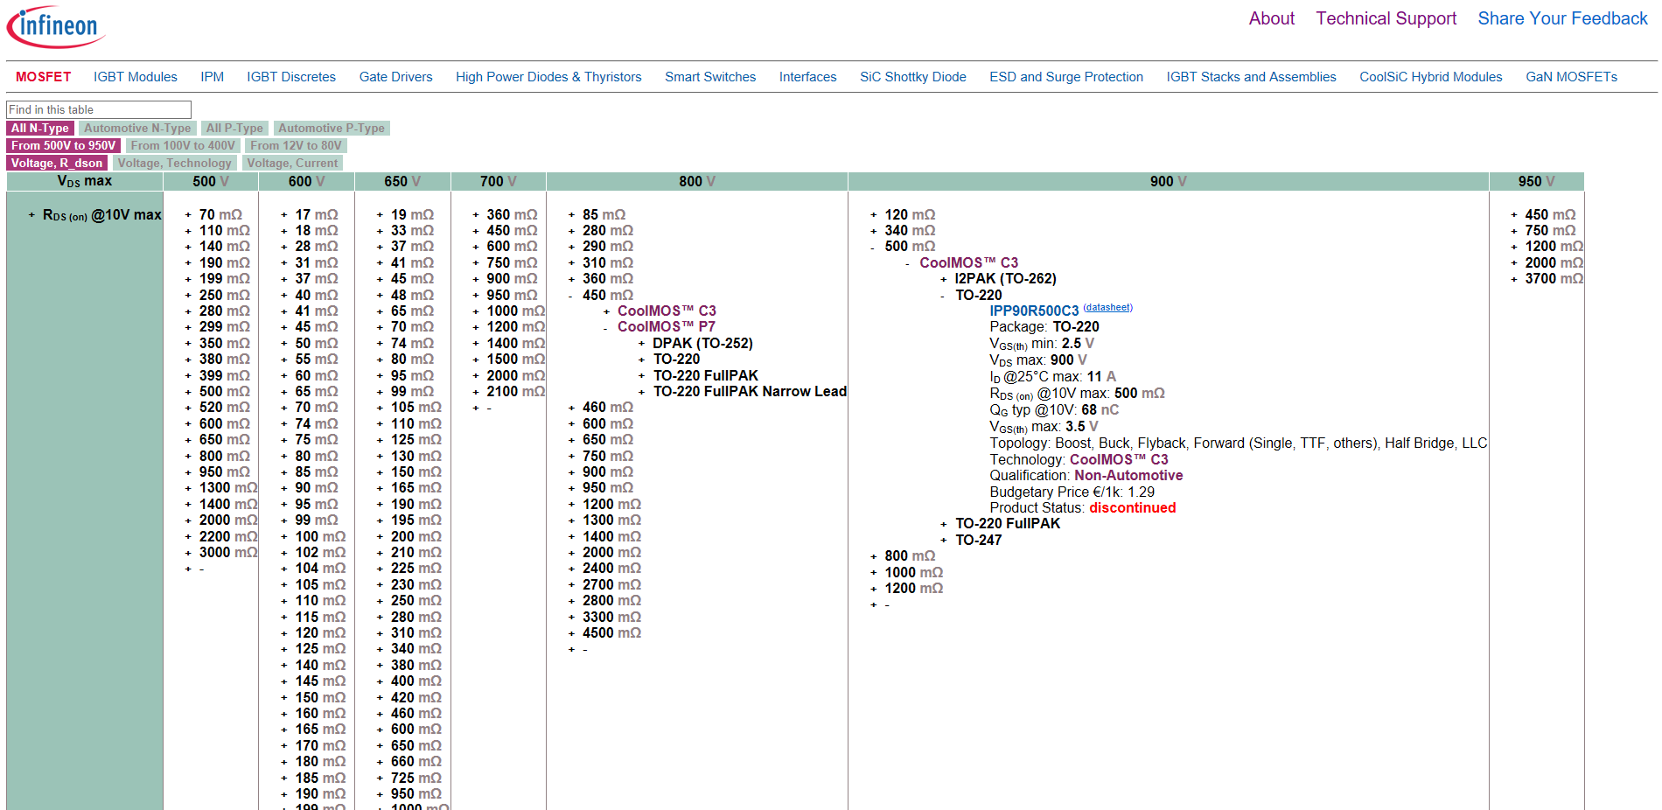
1. Select product category

Slide 5
2. Select subcategories and views

Slide 6
3. Clicking on the table cells, you move through the component parameter tree, choosing a branch according to your technical requirements, up to a particular part number

Slide 7
How to start?
The tool does not require any installation of additional programs on your computer. It is enough to copy the folder with the tool in a convenient place and open the start page (index.html) in a web browser.
Download the latest version of the tool from myInfineon OR from github.com:
Option 1 (recommended) - myInfineon: Login to myInfineon, on the right panel open Simulation and Tools menu, Click on Smart Product Selection Map
Option 2 - Github: Download zip file at https://github.com/vbasov007/Smart_Product_Selection_Map/archive/master.zip
Unzip the archive to a convenient place.
Go to the folder and open the index.html file in the browser (supported: Chrome, Firefox, Opera, Safari and EDGE).

Slide 8
Vasily.Basov@infineon.com
Please send me your feedback, comments, and suggestions!

